Slide 1


Data Science Education Community of Practice (DSECOP)
William Ratcliff (William.Ratcliff@nist.gov)
NIST Center for Neutron Research
Department of Materials Science and Engineering,
Department of Physics
U. Maryland, College Park

Slide 2
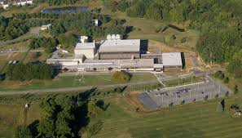
NIST Center for Neutron Research

Slide 3
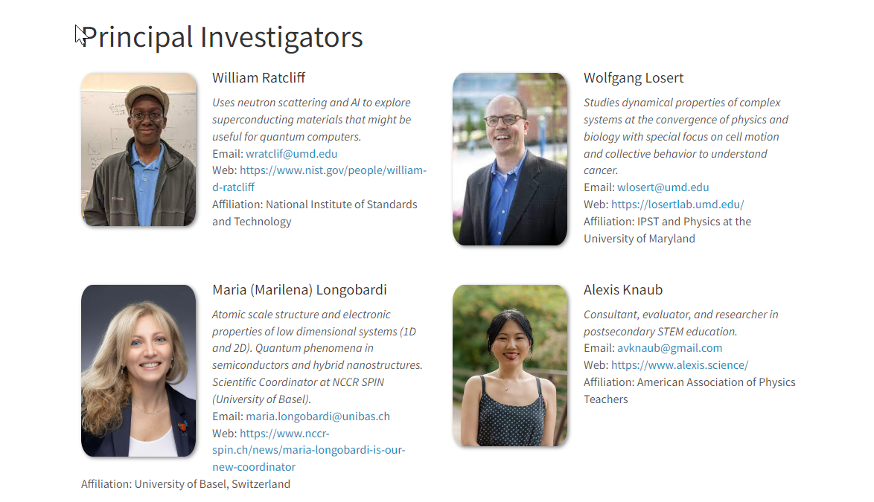

Slide 4
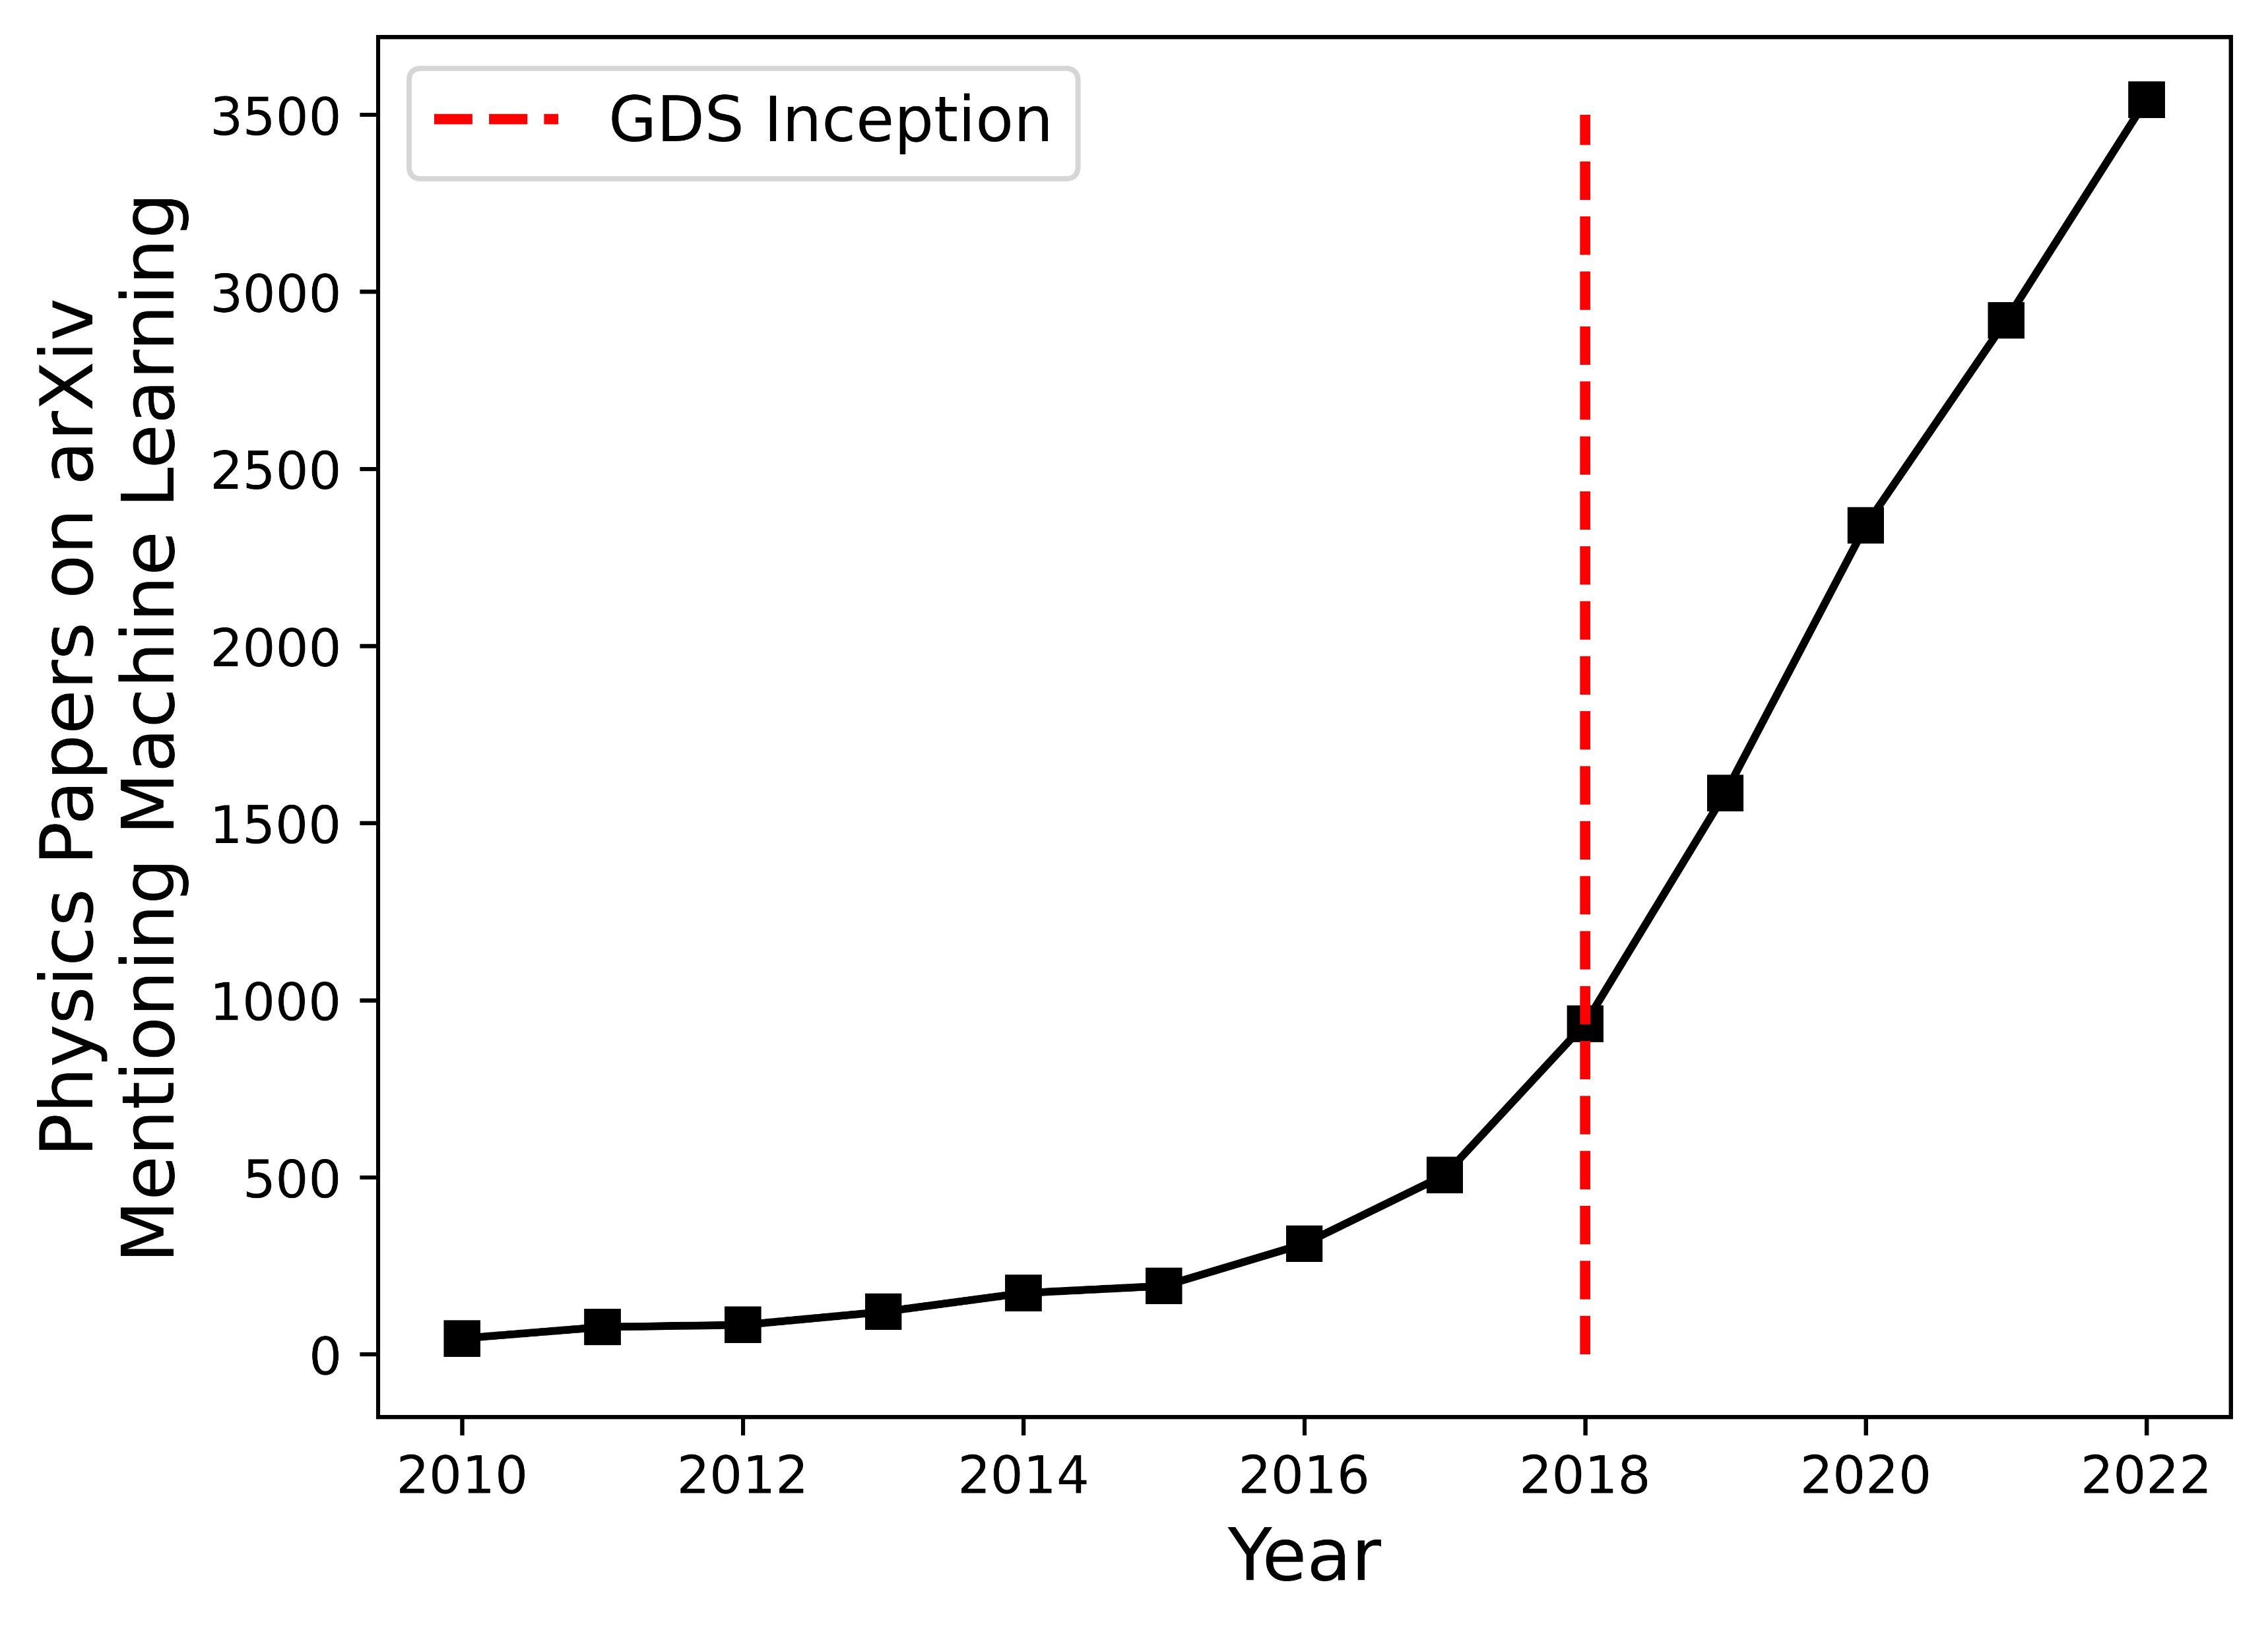

Slide 5
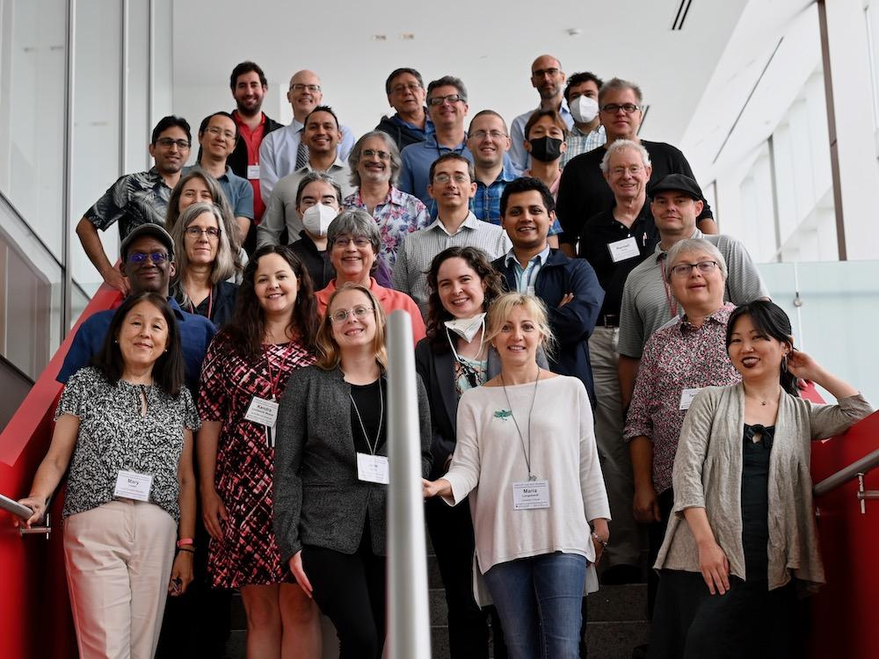
DSECOP
The Data Science Education Community of Practice (DSECOP), a program funded by the APS Innovation Fund and led by the APS Topical Group on Data Science (GDS), is committed to supporting physics educators in integrating data science into their courses.
To achieve this, we organize webinars, workshops, and collaborate with various institutions
DSECOP June 2022 Workshop

Slide 6
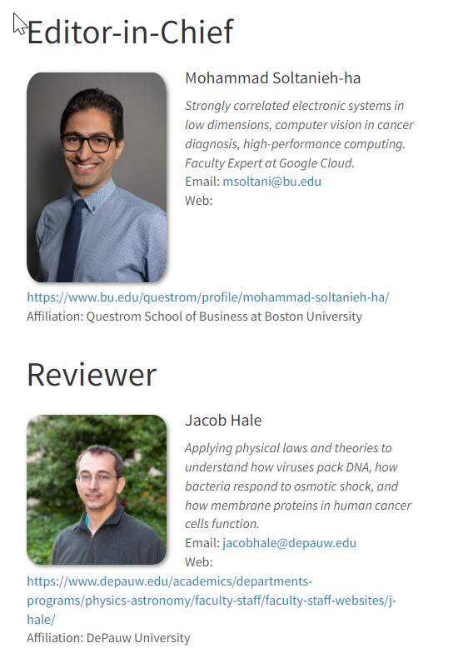
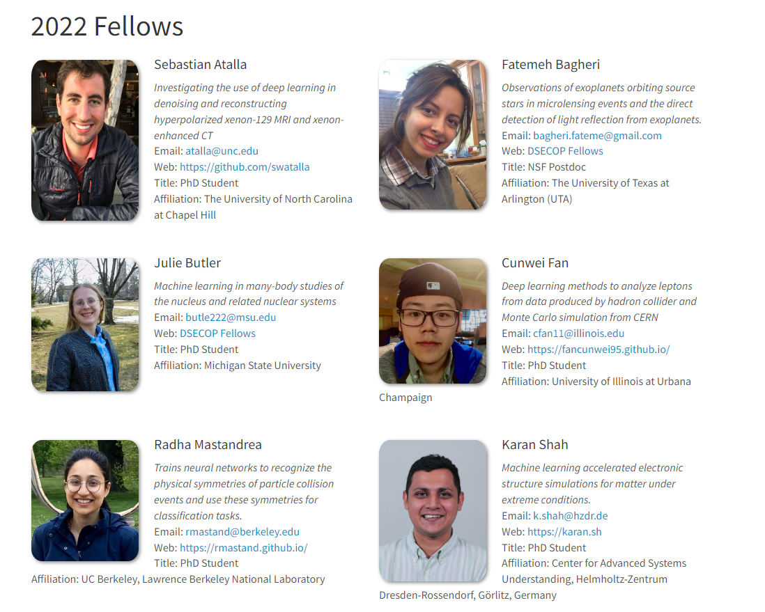
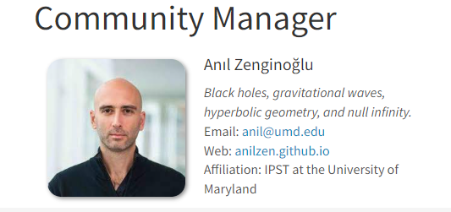

Slide 7
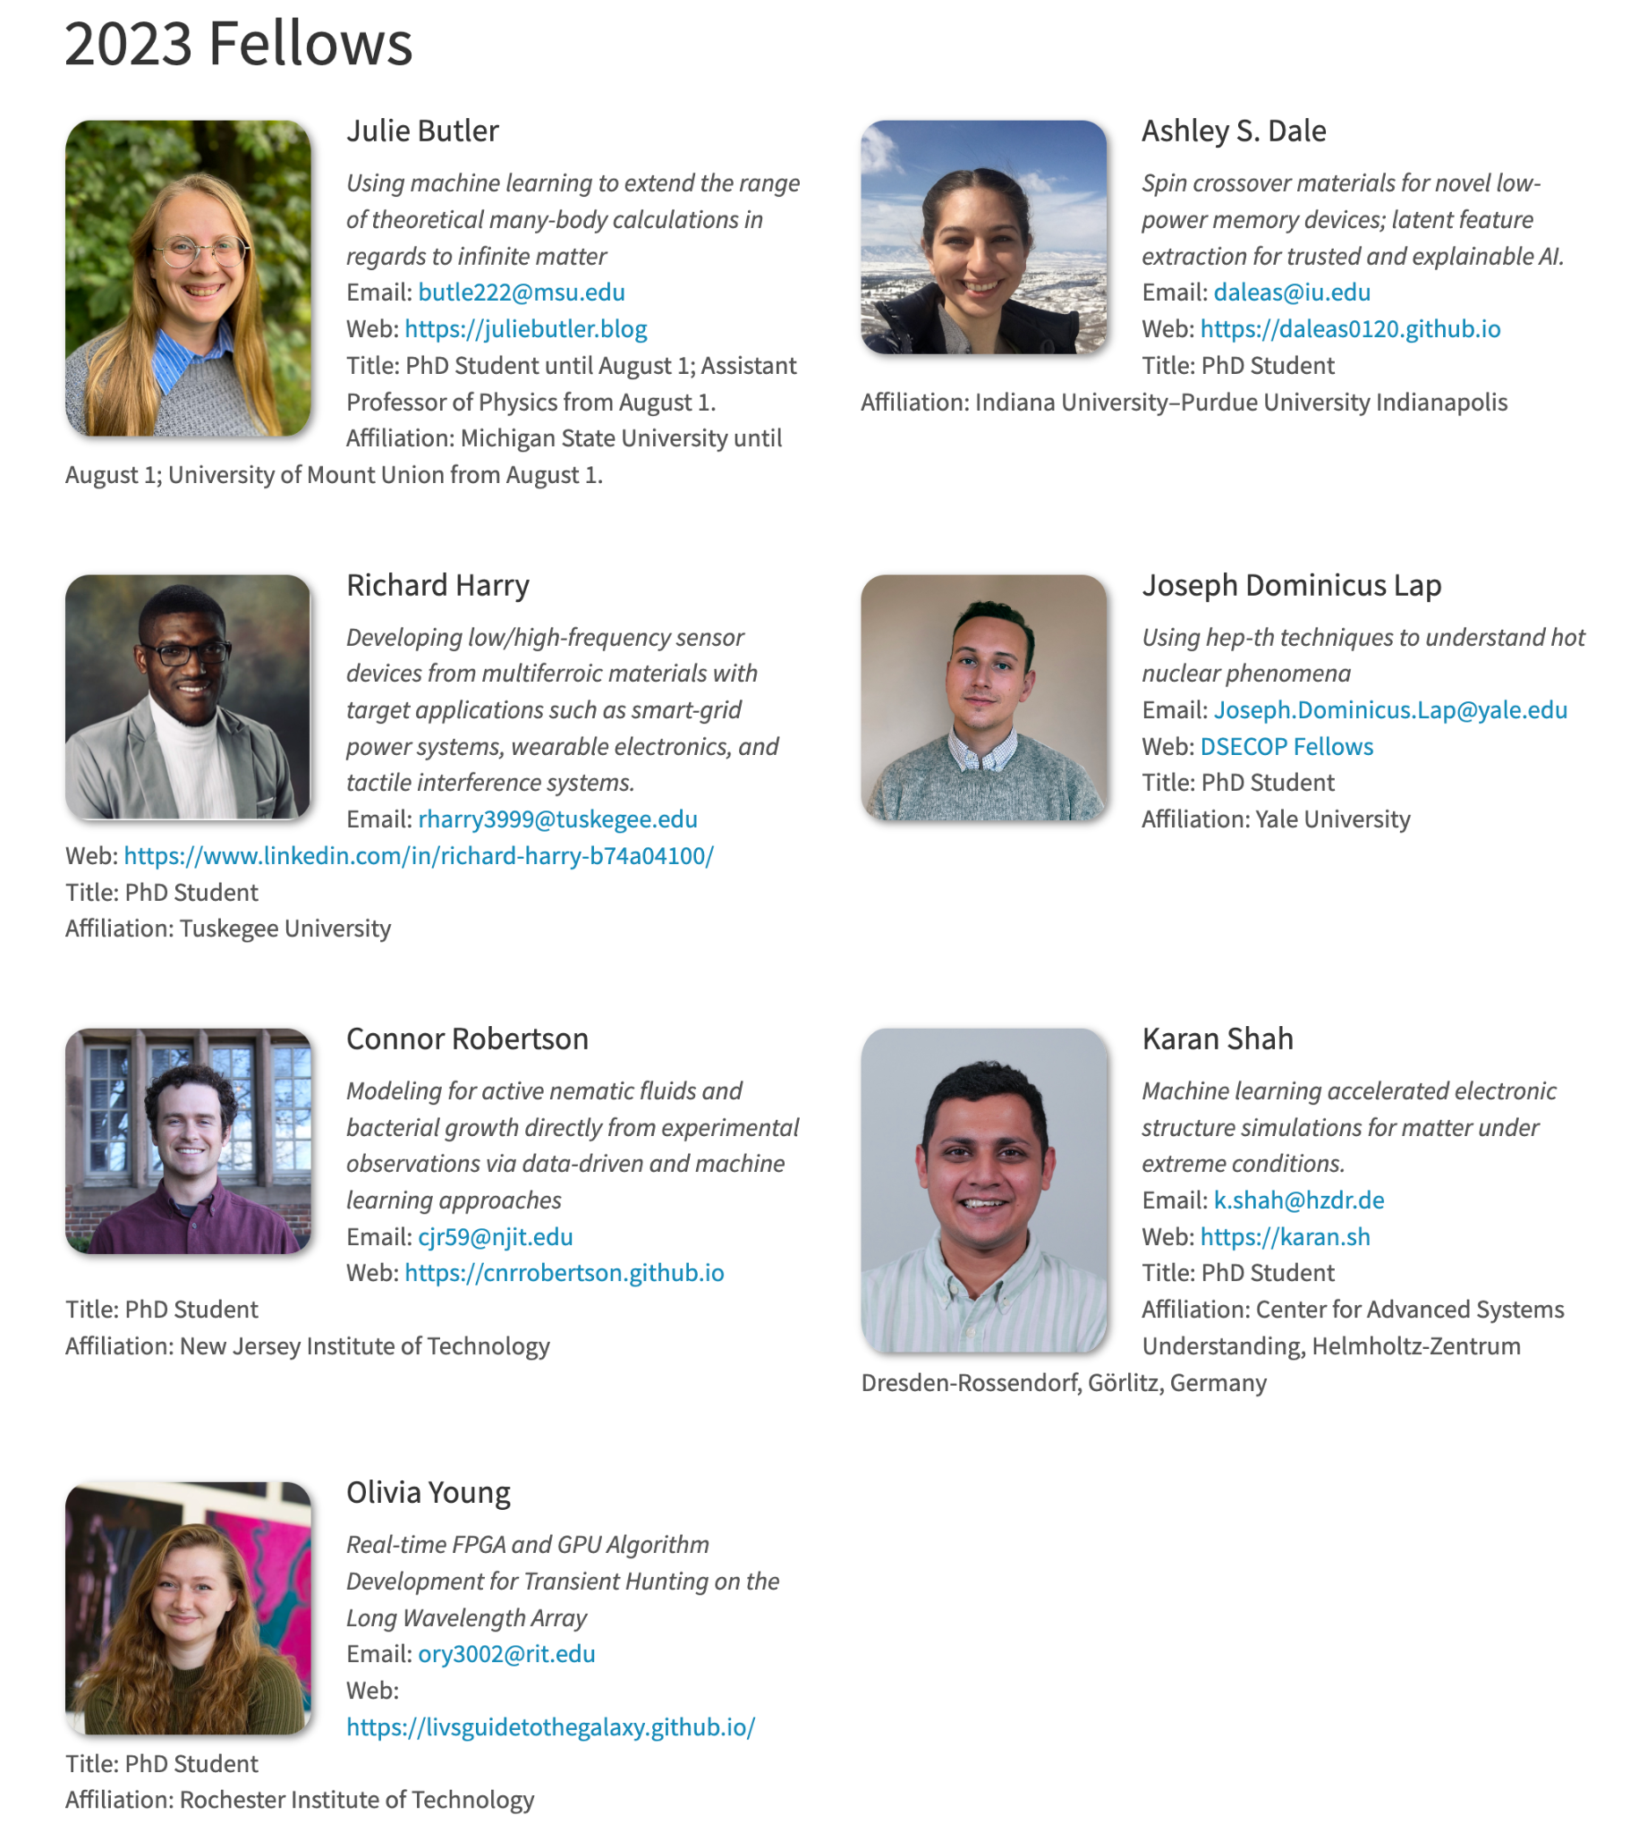
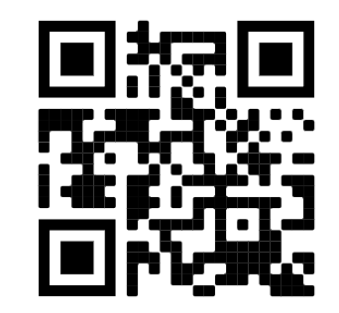
DSECOP Fellows
Team: dsecop.org/team

Slide 8
Modules vs Classes

Slide 9
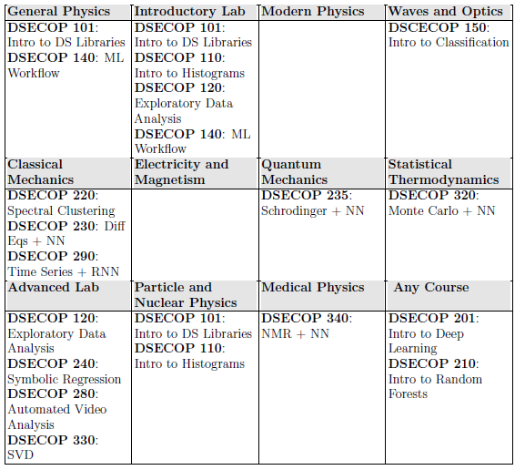

Slide 11
Intro Random Forest
DSECOP 210
Intro to Classification
DSECOP 150
Intro to Histograms
DSECOP 110
Intro to DS Libraries
DSECOP 101
ML Workflow
DSECOP 140
Spectral Clustering
DSECOP 220
Exploratory Data Analysis
DSECOP 120
Intro to Deep Learning
DSECOP 201
SVD
DSECOP 330
Symbolic Regression
DSECOP 240
NMR + NN
DSECOP 340
Diff Eqs + NN
DSECOP 230
Monte Carlo + ML
DSECOP 320
General Data Science Modules
Data Science Level:
DSECOP 1xx: Beginner
DSECOP 2xx: Intermediate
DSECOP 3xx: Advanced
Physics Level:
Beginner
Intermediate
Advanced
Schrodinger + NN
DSECOP 235
Time Series + RNN
DSECOP 290
Automated Object Detection
DSECOP 280
Machine Learning Modules

Slide 12

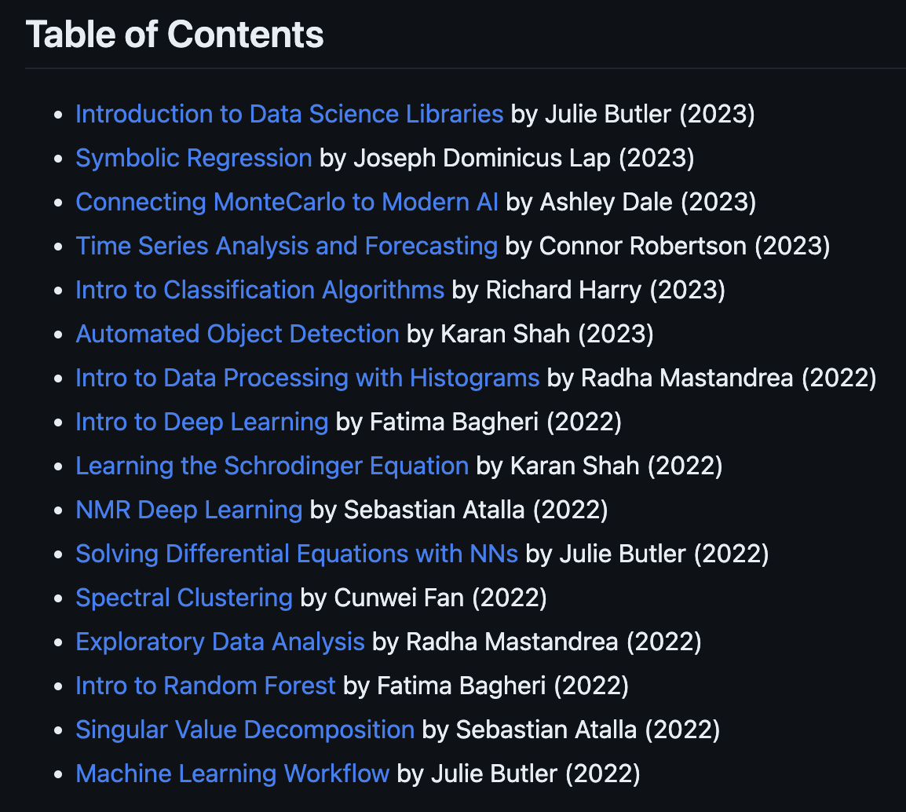
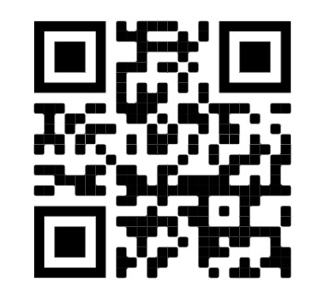
DSECOP: Data Science Education Community of Practice
Preparing students for multiple career paths by offering teaching materials to faculty members who teach undergraduate and graduate physics courses.
GitHub: bit.ly/DSECOP-GitHub

